Slide 1




Optimization of multilayer perceptron output with ReLU activation function
Shashwat Koranne, Hardik Panchal, Zachary Wilson, Nick Sahinidis
Carnegie Mellon University
Shiva Kameswaran, Niranjan Subrahmanya
ExxonMobil Corporate Strategic Research

Slide 2
Problem statement
Build a systematic optimization model which:
Incorporates a ReLU activation function based neural network as the input
Generates a linear model of the output which can be modeled as MILP and solved using Mixed-Integer Programming (MIP) approach
Produces surrogate models that scale well with size and complexity of the system

Slide 3
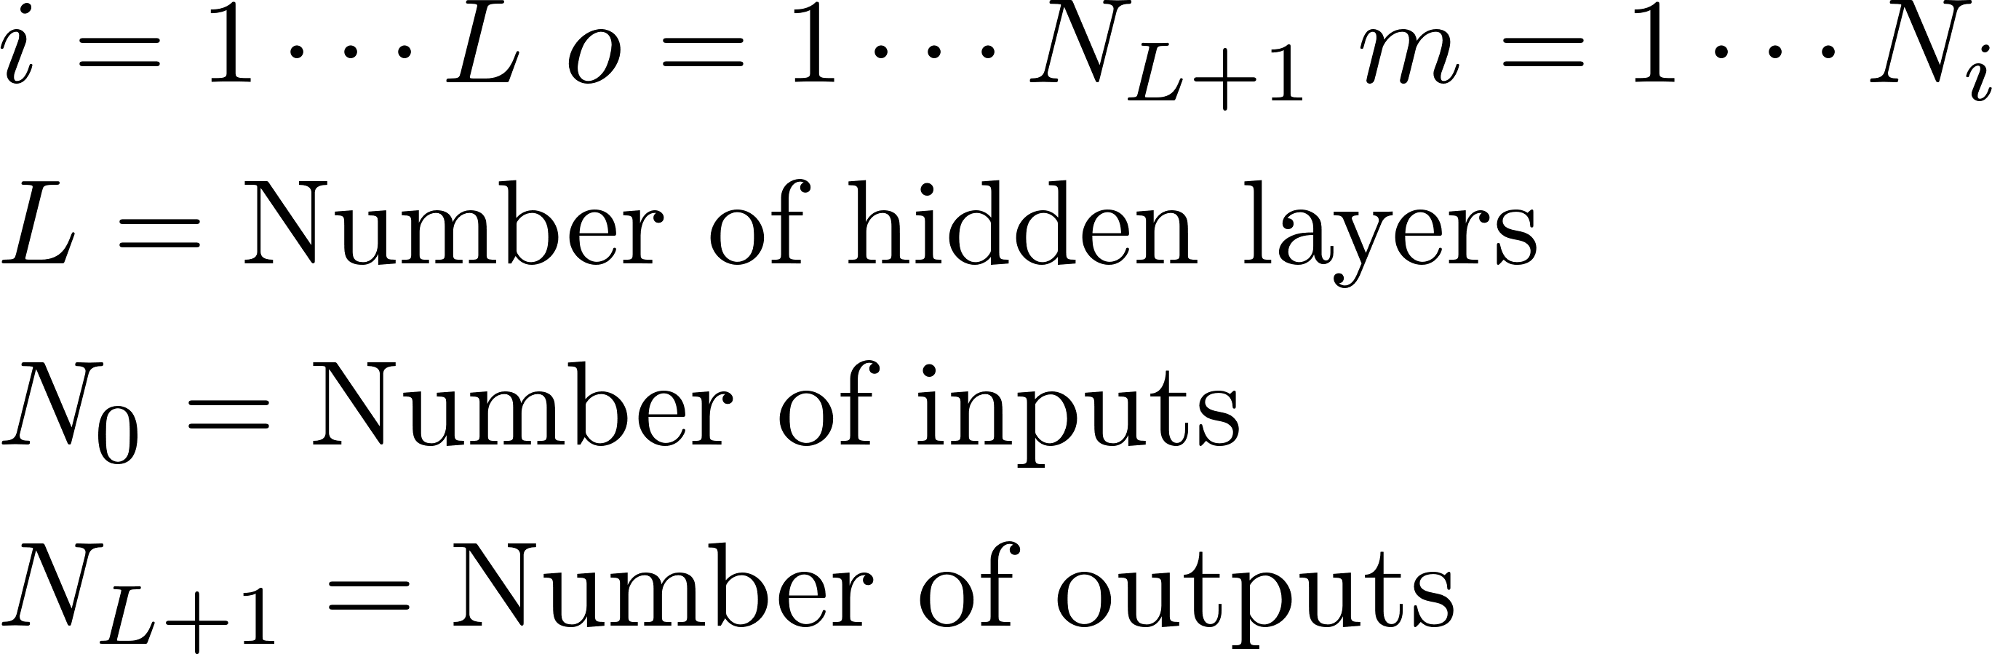
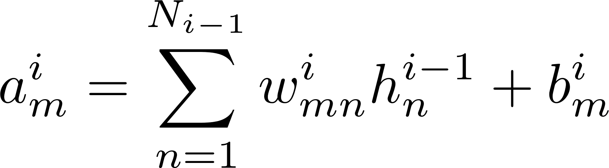
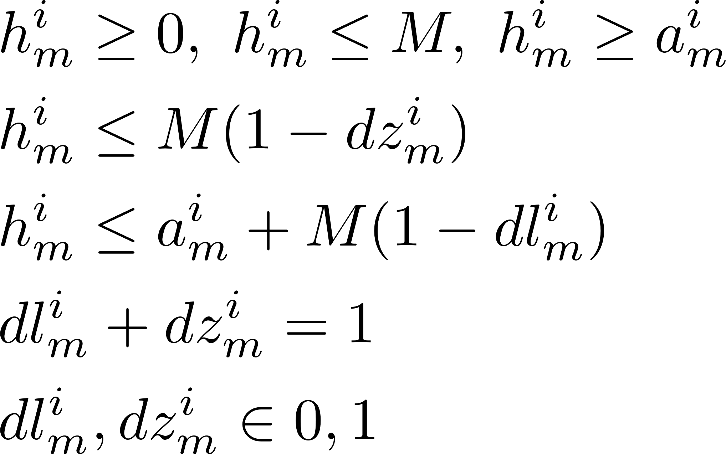
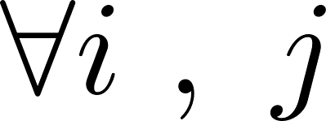
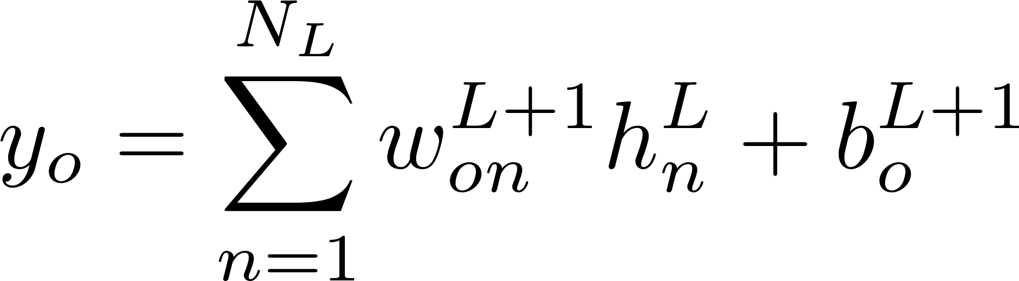
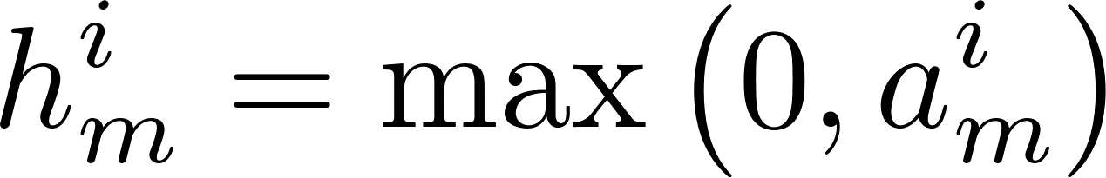
Mixed-integer model
MIP reformulation of the max operator:
The ReLU activation function is written in GAMS using big-M constraints
Governing Equations
Notation
ReLU transfer function
Hidden layer activation
Output function
Every node requires two binary variables

Slide 4
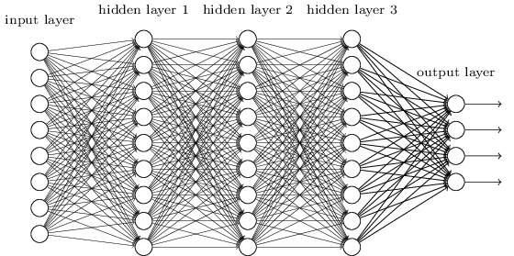
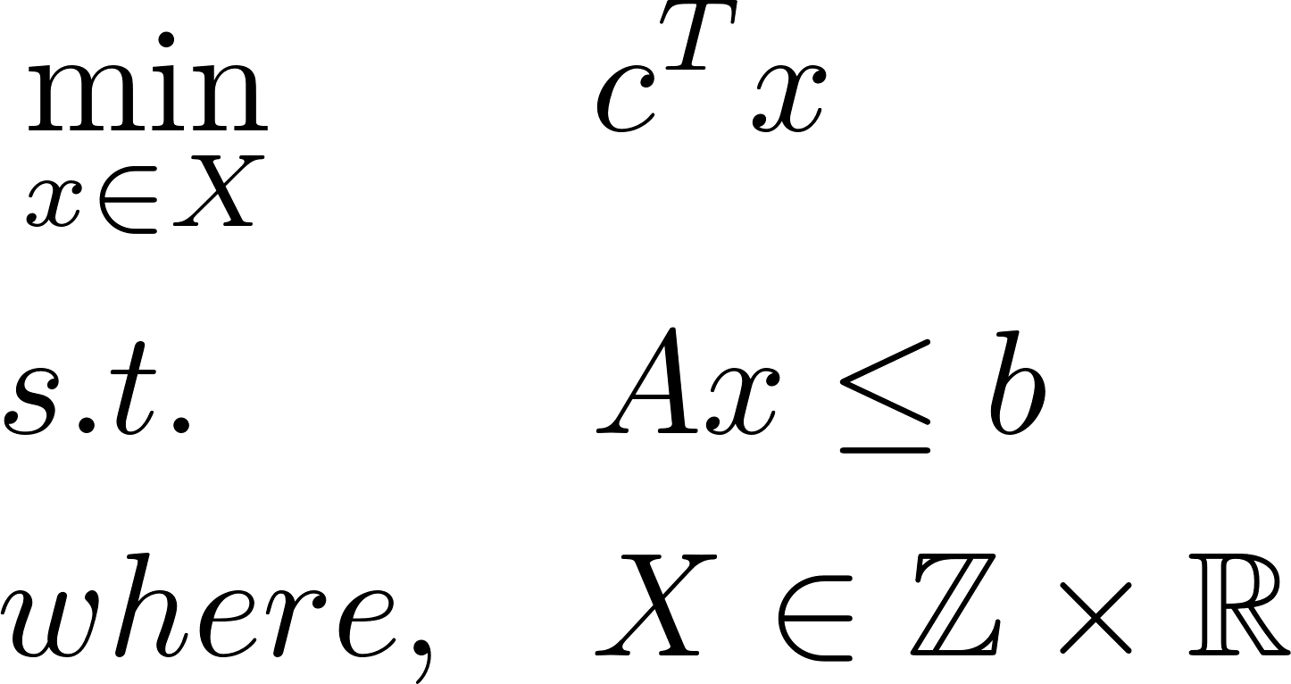
Background and approach
Multi-Layer Perceptron (MLP) is a feedforward artificial neural network
Objective: Optimize the MLP network using a scalable MIP approach.
Specify network structure and train weights and biases
Simple architecture
Deep architecture
Hidden Layer
Input
Output
Generate MIP formulation of ReLU neural network

Slide 5
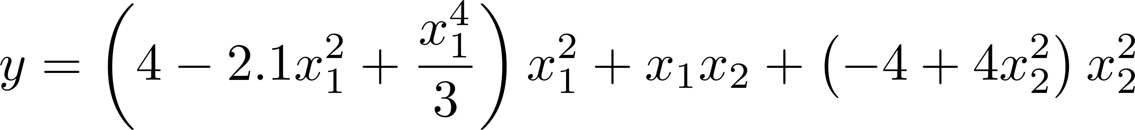
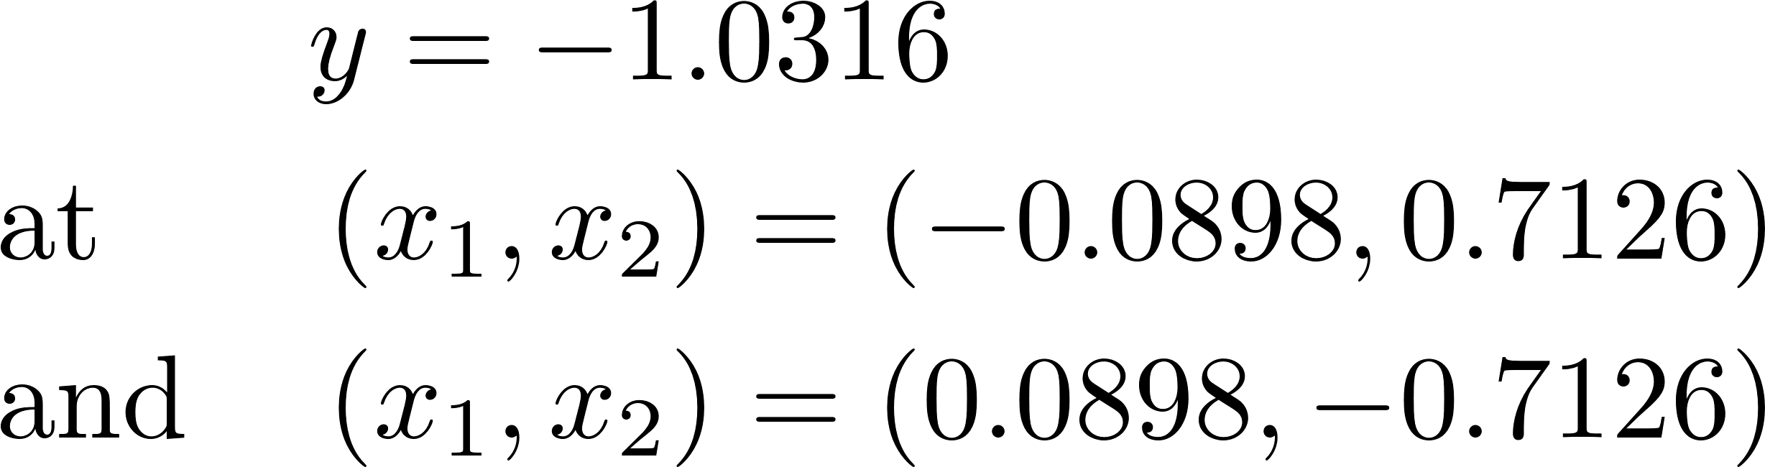
Computational study
Goal: Optimize GAMS model of a trained neural network with linear rectified units utilizing a benchmark example
Algebraic form
Six hump camel function
Global minima

Slide 6
Computational study
ReLU surrogate models
1 hidden layer 10 nodes
1 hidden layer 200 nodes
3 hidden layer 30 nodes
Global minimum
-1.33
0.6
20
46
54
0.013
-1.12
23.7
400
806
1004
1.27
-1.17
6.2
60
126
154
0.12
Training time (s)
Continuous variables
Binary variables
Equations
Solution time (s)

Slide 7
Conclusions
A feed-forward neural network with rectified linear units that
Admits a mixed-integer programming model
Avoids the classical issue of non-convexities induced by traditional transfer functions
Opens neural network optimization and training to rigorous optimization
Future steps will focus on
The application of the MIP formulation to a wide variety of problems stemming from complex systems
Investigation of the scalability of MIP-based ReLU models

